Slide 1
Operations on Processes: Process Creation
Parent process create children processes, which, in turn create other processes, forming a tree of processes.
Resource sharing
Parent and children share all resources.
Children share subset of parent’s resources.
Parent and child share no resources.
Execution
Parent and children execute concurrently.
Parent waits until children terminate.

Slide 2
Process Creation (Cont.)
Address space
Child duplicate of parent.
Child has a program loaded into it.
UNIX examples
fork system call creates new process
exec system call used after a fork to replace the process’ memory space with a new program.

Slide 3
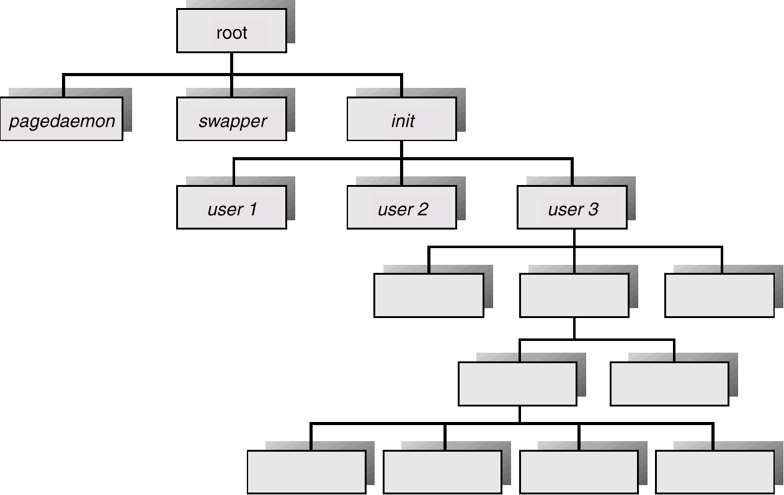
Processes Tree on a UNIX System

Slide 4
Operations on Processes: Process Termination
Process executes last statement and asks the operating system to decide it (exit).
Output data from child to parent (via wait).
Process’ resources are deallocated by operating system.
Parent may terminate execution of children processes (abort).
Child has exceeded allocated resources.
Task assigned to child is no longer required.
Parent is exiting.
Operating system does not allow child to continue if its parent terminates.
Cascading termination.

Slide 5
Cooperating Processes
Independent process cannot affect or be affected by the execution of another process.
Cooperating process can affect or be affected by the execution of another process
Advantages of process cooperation
Information sharing
Computation speed-up
Modularity
Convenience

Slide 6
Producer-Consumer Problem
Paradigm for cooperating processes, producer process produces information that is consumed by a consumer process.
unbounded-buffer places no practical limit on the size of the buffer.
bounded-buffer assumes that there is a fixed buffer size.

Slide 7
Bounded-Buffer – Shared-Memory Solution
Shared data
#define BUFFER_SIZE 10
Typedef struct {
. . .
} item;
item buffer[BUFFER_SIZE];
int in = 0;
int out = 0;
Solution is correct, but can only use BUFFER_SIZE-1 elements

Slide 8
Bounded-Buffer – Producer Process
item nextProduced;
while (1) {
while (((in + 1) % BUFFER_SIZE) == out)
; /* do nothing */
buffer[in] = nextProduced;
in = (in + 1) % BUFFER_SIZE;
}

Slide 9
Bounded-Buffer – Consumer Process
item nextConsumed;
while (1) {
while (in == out)
; /* do nothing */
nextConsumed = buffer[out];
out = (out + 1) % BUFFER_SIZE;
}

